Slide 1

DEPARTMENT OF INFORMATION SCIENCE & ENGINEERING
“NGO Website”
COURSE NAME : MINI PROJECT
COURSE CODE: 20ISE59A
Presentation by,
1NH20IS101 Nitish Veni
1NH20IS083 Manoj H
Under the Guidance of ,
Guide Name: Mrs. Priya N
Designation: Assistant Professor

Slide 2
Agenda
Introduction
Existing system
Problem Definition
Objectives
Design modules
Algorithm / Flow chart
Conclusion
References

Slide 3
Introduction
Poverty, hunger and health care are the main problem of our country. There are many NGO’s or Organizations that are working to minimize poverty and hunger in society. NGO (Nongovernmental organization) is a term that has become widely accepted for referring to a legally constituted, non-business organization created by natural or legal persons with no participation or representation of any government. These organizations take donations for this purpose and arrange fund raising events/ processes so that everyone can donate. This project will build an efficient management system for such organizations to manage their resources and donations.

Slide 4
Existing systems
The existing system is a website.
It consists of all the information regarding the domain they are willing to work for.
The website contains all the details about the work which they conduct and worship where it takes place.

Slide 5
Problem Definition
To be able to implement stress free money transactions.
To be able to reach majority of population all across the world
To be able to get receipts to their mobile phones.

Slide 6
Objectives
To fight against exploitation, injustice and corruption if found against any individual, class, community in the society.
To provide help under health & nutrition services for women and children.
To provide a forum for the exchange of ideas on the social, cultural and educational conditions of society to collaborate with other NGO’s working towards similar goals.

Slide 7
Design Modules
Web Standards Used
Hypertext Markup Language Syntax Tags.
Cascading Style Sheets.
Java Script.

Slide 8
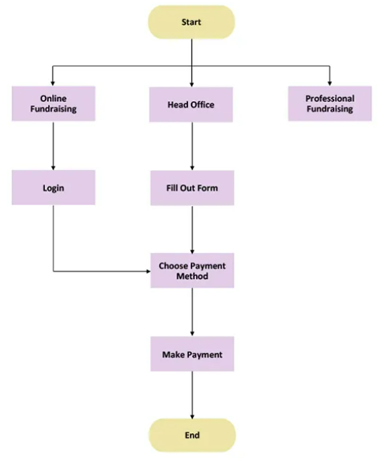
Flowchart

Slide 9
Conclusion
Work done by NGO goes a long way for a nation building.
In countries where the NGO/Government collaboration is strong, the impact of the activities is greater and more sustainable.
NGO’s need to be transparent in their work and ensure that the fund raised, benefit those for whom they are intended.

Slide 10
References
[1] Rapporteur 1, E. G. I. (29 October 2019). "Europe in a suitcase: Oliver Wardrop Discussions". Europe-Georgia Institute. Retrieved 31 March 2021.
[2] Church, Jim (26 August 2021). "Library Guides: Non Governmental Organizations (NGOs): Introduction". guides.lib.berkeley.edu. Archived from the original on 26 August 2021. Retrieved 26 August 2021.

Slide 11
Thank you

